Slide 1
Welcome to Mrs. Atkins’ 4th Grade Class
Thank you for joining us tonight. Please come in and look around. I will be covering a lot of information that will hopefully be helpful and useful to you.

Slide 2
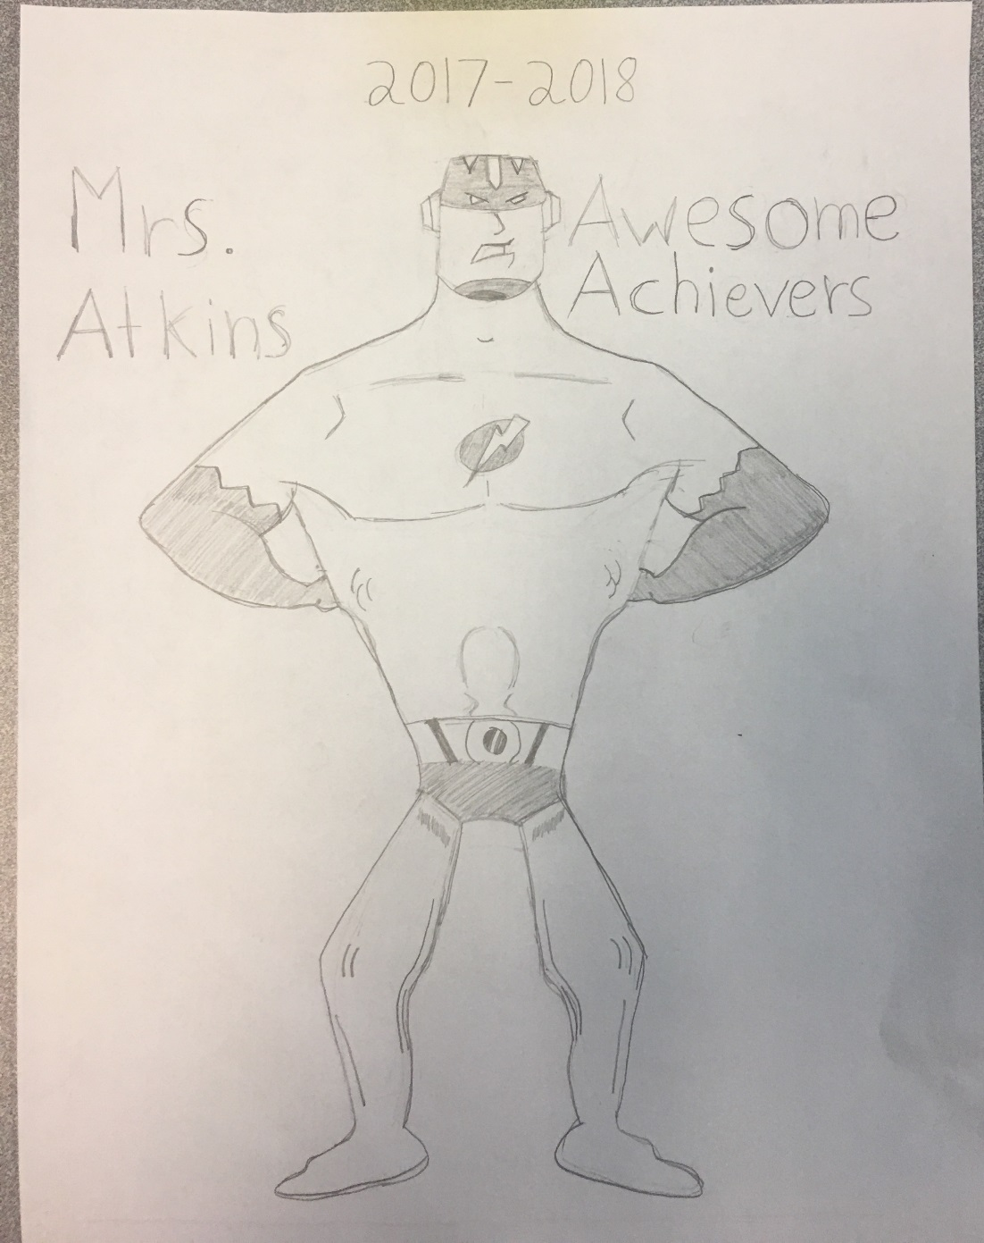
Our class name: Mrs. Atkins’ Awesome Achievers
Design By: Zachary Archer

Slide 3
Student Expectations
Students are expected to follow all class & school rules at all times. This is for the safety and success of all students.
Respect yourself and others
CHOMP
Complete all class and home assignments daily
Arrive on time, fill out agenda daily

Slide 4
CHOMP
C- cooperate with others
H- be honest and set a good example
O- be on task and always do our best
M- be mindful and treat others with respect
P- come to school prepared to learn
Classes earn CHOMPliments from teachers in the hallways, at specials and various other times of the day. As classes reach levels of 50 they are given a reward for their hard work. We are currently at .

Slide 5
Student Behavior
If students do not follow the school or class rules the following actions will take place:
Verbal warning (2)
Lose Class Dojo points
Note in agenda/e-mail/discussion with student and loss of free choice for part of recess
Phone call home
The exception. . .

Slide 6
Standards Based Grading
LEVEL DESCRIPTOR
4 – Exemplary - Student consistently demonstrates an in-depth understanding of the standards, concepts, and skills taught during this reporting period.
3 – Proficient: Student consistently demonstrates an understanding of the standards, concepts and skills taught during this reporting period.
2 – Approaching Proficiency: Student is approaching an understanding of the standards, concepts and skills taught during this reporting period.
1 – Non-Proficiency: Student does not yet demonstrate an understanding of standards, concepts and skills taught during this reporting period.
-Wake County Public Schools

Slide 7
Schedule
Our specials are on a 7 day rotation – art, tech/media, pe, engineering (science), guidance, and enrichment (Specials for the next week are located on the Friday Newsletter)
Therefore, each special will not be on the same day each week.
We will be changing rooms this school year so our lunch times and rooms may change when we track in. The new lunch times, schedules and dates are on my website. I will also let you know in the newsletter.
Students must wear tennis shoes on p.e. day

Slide 8
Curriculum
Reading: Main Idea & Details, Theme, Inferring, First & Secondhand accounts, Point of view, summarizing, Characters in Historical Fiction, Text Structures, Research, Social Issues, Test Prep
Writing: Narratives (Realistic Fiction), Research, Opinion, and Persuasive Essays
Math: Big Changes (adding, subtracting, and multiplying fractions, angles, multi-digit multiplication, long division, decimals)
Science: Animal studies, earth materials, landforms, and Magnetism and Electricity
Social Studies: All About NC! (History (key historical events, symbols, and structures), Government (NC Constitution), Economy, Culture, Geography, and Environmental Literacy)

Slide 9
Daily 5 (Literacy Rotations)
Read to Self, Work on Writing, Fluency/Literacy Games, MobyMax
For Teachers…..
Deliver 3 whole group lessons each day
Teach 3 small groups of children each day
Confer with individual students each day (during writing)
Hold all students accountable for eyes-on-text
For Students…..
Engaged in the act of reading and writing for extended amounts of time
Receive focused instruction on building and maintaining independence
Receive tailored instruction through whole group, small group, and/or individual conferring, by their skilled classroom teacher, each day

Slide 10
Vocabulary
Each week students will receive 10-20 spelling words (depending on the word list)
Each night students will complete one activity from the Vocabulary Choice list
Students are responsible for knowing the meaning of the word, not the spelling unless specified

Slide 11
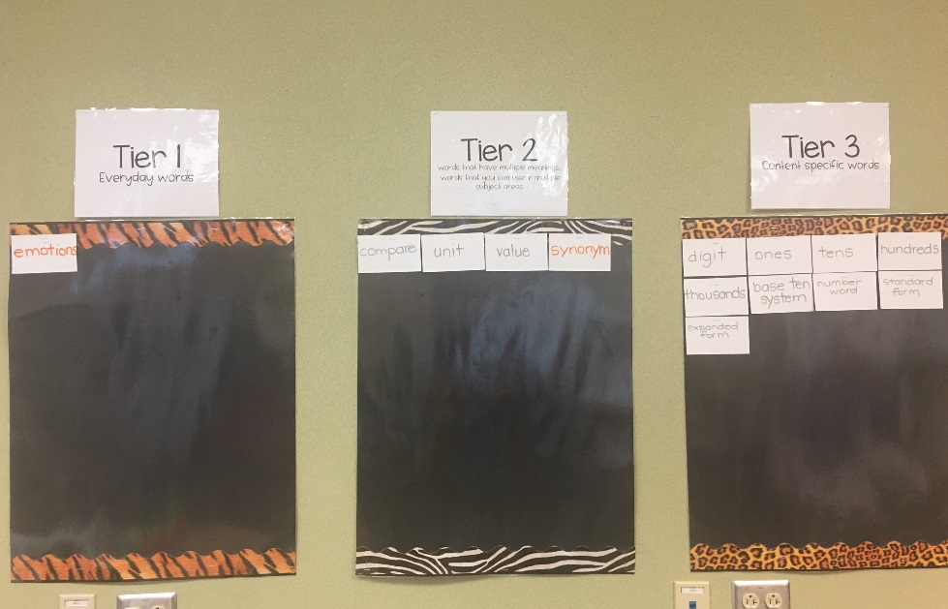
Tiered Word Wall
We will be adding important and essential vocabulary to our Tiered Word Wall
There are 3 Tiers, students will determine which tier best fits the word.
Tier 1- everyday words
Tier 2- multi-meaning words, words that are used in multiple subject areas
Tier 3- content specific words

Slide 12
Homework
Homework should take no more than one hour to complete
Reading- Students should read for at least 20 minutes then respond to one of the comprehension questions in their homework folder
Vocabulary- Students should choose a different vocabulary activity to complete each night (20 minutes)
Reading and Vocabulary are due on Friday
Math- There will be math homework that corresponds with that days learning, unless we had an assessment during class. In that case, there will be no math homework. (Due Daily)

Slide 13
Agendas
Students write their homework and important information down each night in their agenda.
Please initial them each night and feel free to communicate with me via this resource
This year the agendas are free thanks
to our wonderful PTA ☺

Slide 14
Data Binders
Every other Friday students will bring their data binders home
Please sign the form in the front saying that you saw their work
Send the binder back on Monday
Binders will come home next Friday, August 18th

Slide 15
Conferences
Conferences are held 1st (Parent/Teacher) and 3rd (Student Led) quarters.
If you would like a conference you may request one at any time.
When it is time for conferences I will send out a sign up genius via e-mail.
Phone conferences are also available, however you cannot see your child’s progress and work samples if you don’t come in person.

Slide 16
Friday Folders
Friday Folders go home weekly
Please look over the work that your child has done throughout the week, as well as any other important papers from school.
I will send a weekly newsletter each Friday (email).

Slide 17
Field Trips
NC Zoo: September 28th (unlimited chaperones)
NC Symphony: April 26th (no chaperones)
Mordecai House: March 23rd (limited Chaperones- 4)
Please fill out the volunteer registration online either in the computer lab or the library if you want to volunteer.

Slide 18
Volunteering/Room Moms
Our room moms this year are Lori F., Joanne B., Emily D., and Becky H.
If you want to volunteer on a field trip or classroom event you need to sign up beforehand through the county.
There are computers in the media center to sign up today.

Slide 19
Technology
BYOD
Croc Commons – Green Screen, Devices
Google Classroom (drive, docs, etc.)
Kahoot!
Moby Max
Research writing
Coding – program robots

Slide 20
Transportation
Changes in Transportation need to be sent by letter or email.
Bus- all students who ride the bus (am, pm, or both) must have a yellow ridership tag on their backpacks. They will not be allowed on the bus without this tag. Report lost tags as soon as possible.
Must ride the bus at least once during the first 10 days or their name will be taken off the stop and the stop might be taken off the route
Due to new tag system, students will not be able to ride the bus home with a friend/relative if they are not assigned to that bus.

Slide 21
Go, Play, Save
Go, Play, Save books were sent home Tuesday.
All books and orders are due on Aug. 26th.

Slide 22
Contact
Weekly Newsletter (sent every Friday)
Website (updated weekly): mrsatkins4thgradesafari.weebly.com
Agendas
Conferences
Friday Folders
Class Dojo (Message and Class Story Features)
Twitter: @AtkinsAllstars (public)
Email: aatkins@wcpss.net
Interims and Report Cards
Phone 919-841-4333

